Slide 1
An Coimisiún Pleanála
Stakeholder Engagement July 2025

Slide 2
Planning and Development Act – Part 17
Change in Roles
Part 17 of P&D Act 2024 was commenced on the 18th of June 2025.
New Governance Structure - New Governing Board announced by Minister following recruitment process run by Public Jobs. The Chairperson of the Governing Board is Paul Reid.
The Chairperson of An Bord Pleanála became the Chief Executive Officer (CEO) of the Commission.
The Deputy Chairperson became the Deputy Chief Planning Commissioner, and 13 Board members became Planning Commissioner.
The Role of Chief Planning Commissioner to be filled following a recruitment process run by Public Jobs.

Slide 3
Planning and Development Act – Part 17
Governing Board
The Commission shall have a Governing Board.
The Governing Board shall—
  review and guide the strategic direction of the Commission,
  review and oversee the implementation of major plans of action, risk management policies and procedures, annual budgets, and business plans of the Commission,
  set the performance objectives of the Commission, and monitor the attainment of those objectives by the Commission, and
  approve and oversee significant capital expenditure by, and investment decisions of, the Commission.

Slide 4
Planning and Development Act – Part 17
Code of conduct and Written Procedures Document
The Governing Board shall adopt the first code of conduct within 6 months of the commencement of Part 17 and publish on the website.
  The code of conduct will apply to:
    a member of the Governing Board,
    a Planning Commissioner,
    all staff of the Commission and Consultants
The Chief Executive Officer shall, following consultation with the Chief/Deputy Planning Commissioner, prepare procedures to be followed by the Commissioners and inspectors when performing their functions. The procedures will be approved by Governing Board within 6 months of the commencement of Part 17 and published on the website.

Slide 5
Planning and Development Act – Part 17
Review of performance of Commission
The Governing Board shall supply the Minister with such information relating to the performance of the Commission’s functions as he or she may request.
The Governing Board, or the Chief Executive Officer on the request of the Governing Board, shall conduct not less than once every 3 years, a review of the Commission’s organisation and of the systems and procedures used by the Commission in relation to the consideration and determination of cases.
The Governing Board shall report to the Minister the results of the review.

Slide 6
Planning and Development Act – Part 17
Chief Executive Officer
The Chief Executive Officer shall;
  in consultation with the Governing Board, carry on and manage, and control generally, the administration and business of the Commission,
  advise the Governing Board, and make proposals to it in relation to the performance of the Commission’s functions, and
  in consultation with the Governing Board, perform such other functions as may be delegated to them by the Governing Board.
The Chief Executive Officer shall attend meetings of the Governing Board and give such information to the Governing Board as it may require and shall be entitled to speak at and advise such meetings but shall not be entitled to vote at meetings of the Governing Board.

Slide 7
Planning and Development Act – Part 17
Planning Commissioners
The Planning Commissioners shall be composed of:
  the Chief Planning Commissioner,
  the Deputy Chief Planning Commissioner, and
  13 ordinary Planning Commissioner
The Planning Commissioners shall:
  perform the functions of the Commission save where the function is assigned to the Governing Board, and
  In particular, consider and determine an appeal, application, referral or request required to be considered and determined by the Commission.
The Planning Commissioners shall:
  comply with procedures approved under section 503, and
  be independent in the performance of their functions.

Slide 8
An Bord Pleanála
Performance to 27th June

Slide 9
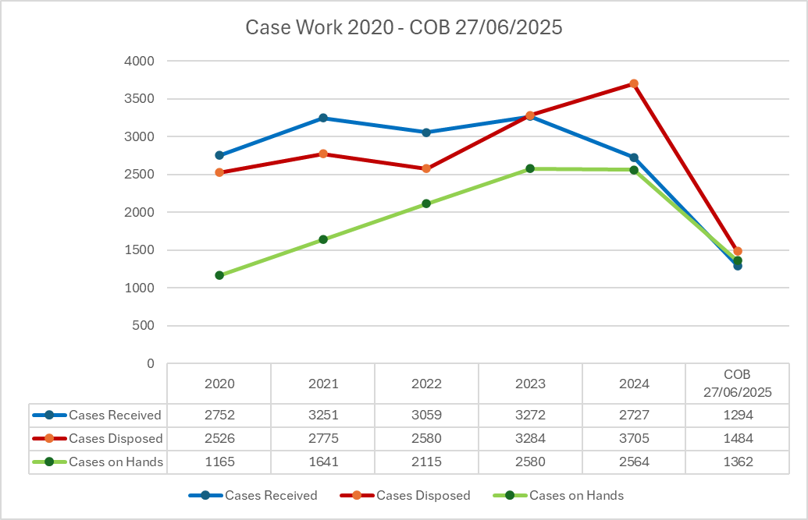
Case Work Overview 2020 – COB 27/06/2025
Intake of Cases, Disposed of and On Hands

Slide 10
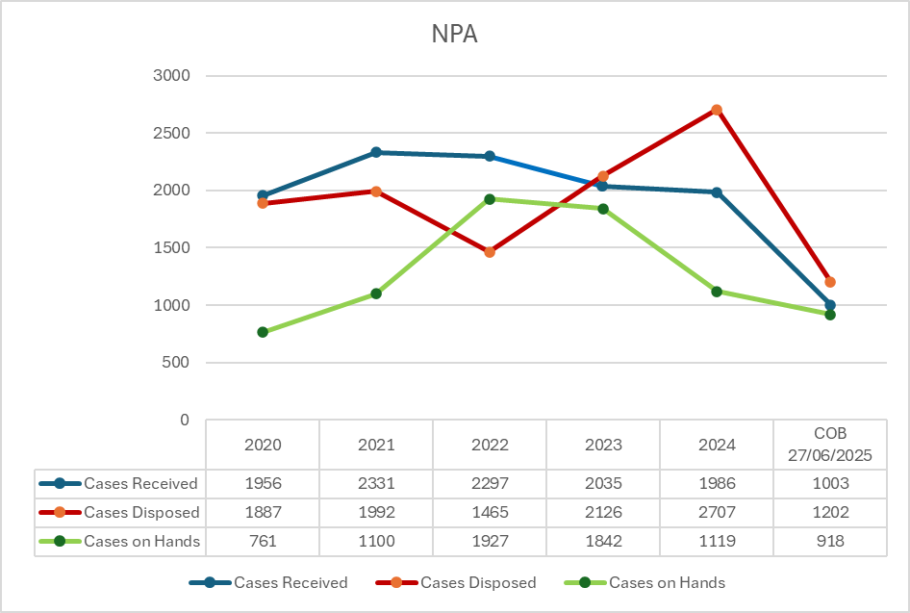
Normal Planning Appeals (NPA)
2020 – COB 27/06/2025

Slide 11
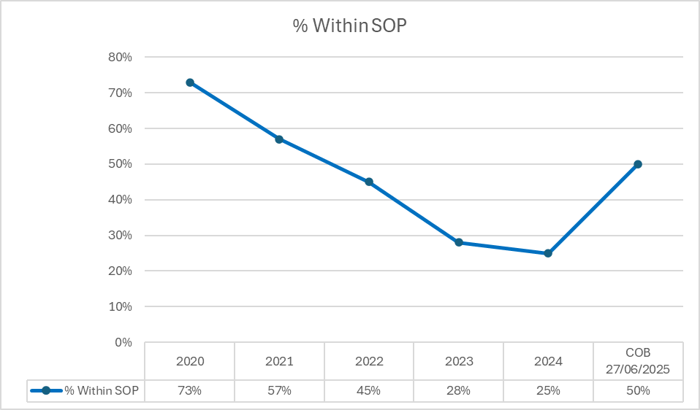
Compliance with Statutory Objective Period – all Cases 2020 – COB 27/06/2025

Slide 12
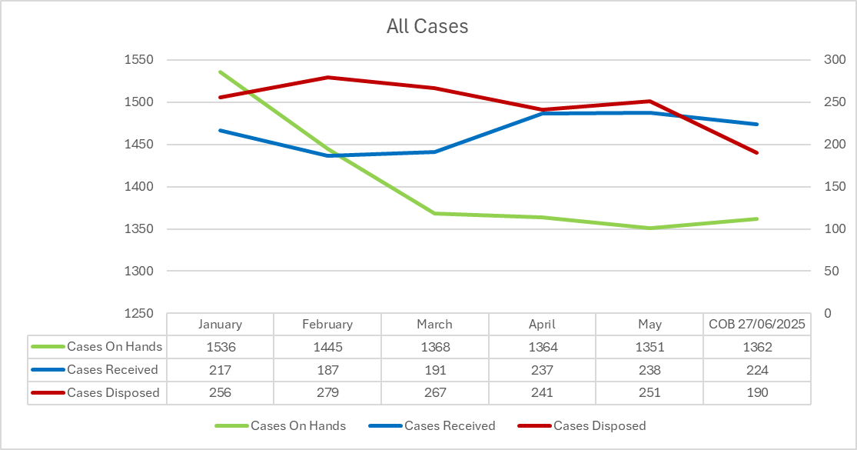
2025 - All Cases – January – June
Intake – YTD 1,294 Disposed of – 1,484 On hands 1,362 Formally Disposed of 1,241

Slide 13
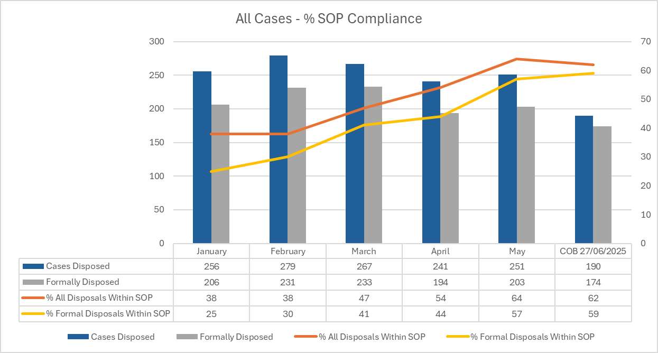
2025 - SOP Compliance
All Cases – 50% YTD 62% to COB 27/06/2025

Slide 14
LRDs, SHDs and 30+ Housing

Slide 15
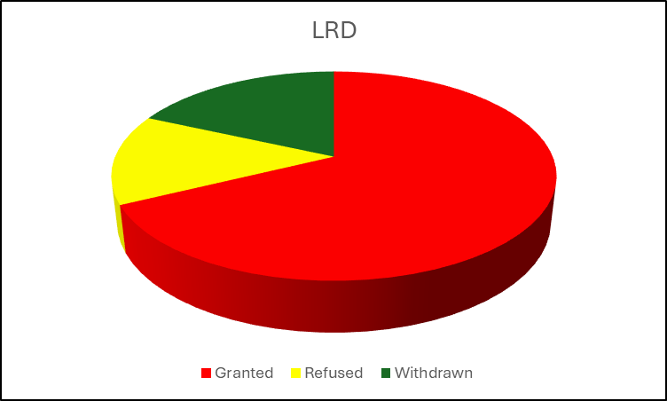
Large Scale Residential Development
Key Information
January 2024 – June 2025
113 cases disposed*
76 LRD cases decided by the Commission (63 grants and 13 refused). 17 cases withdrawn.
100% of cases disposed of by the Commission within the statutory time frame of 16 weeks.
Currently 24 cases on hand.
*includes appeals dismissed, invalid etc.

Slide 16
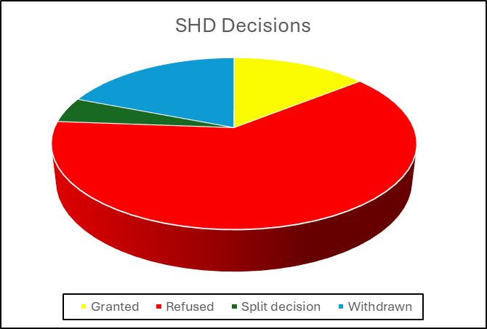
Strategic Housing Development
Decisions to Date (Post Crofton)
April 2024 to June 2025
Decision | No.
Granted (3 of which are now under JR) | 6
Refused (1 of which is now under JR) | 26
Split Decision | 2
Withdrawn | 8
Total | 42

Slide 17
SHD Rate of Refusal/Grant
Based on 34 cases decided since April 2024 and 26 cases refused to date – the current rate of refusal is 76.5%.
Based on 34 cases decided since April 2024 and 6 cases granted the current grant rate is 17.5%.

Slide 18
Strategic Housing Development
April 2024 to July 2025
Further 10 cases at Board Level – generally decided within next 4 weeks
Further 3 cases with Inspectorate to be discharged early July
16 remitted cases – to be decided Q3/Q4
SHD | No.
On Hand With Board | 10
On Hand with Inspectorate | 3
Legal Stay | 1
Remitted | 16
Conceded/Waiting Instruction | 28
Total | 58

Slide 19
30+ Housing - Summary
Prioritised Case Type
73 no. 30+ cases January 2024 to June 2025 –
Cases On Hand: 58 no. 30+ cases
Pre 2024 – 5 cases – legal issues/FI
2024 – 16 cases on hand (9 at Board level, remaining 7 with Inspectorate - imminent discharge)
2025 – 37 cases on hand (9 at Board level, 18 at Inspectorate, 10 at Screening – SOP compliant)
Status | No.
Granted | 33
Refused | 26
Withdrawn | 11
Dismissed | 1
Contribution | 2
Total | 73
Year | Average No. of Weeks – Formal Disposals
2024 | 34.5
2025 | 16.74

Slide 20
30+ Housing Schemes
Cases on Hand
Year | Screening | Analyse | Decide | Legal Stay | Total
2023 |  |  | 2 |  | 2
2024 | 0 | 7 | 9 |  | 16
2025 | 10 | 18 | 9 |  | 37
Legal Stay |  |  |  | 3 | 3
Total | 10 | 25 | 20 | 3 | 58

Slide 21
Strategic Infrastructure and Direct Applications

Slide 22
MARINE Applications
All six Phase 1 ORE projects received and live
  Oriel, NISA and Arklow lodged Summer 24
    Substantial Further Information Request issued 10th April 2025 with 9 months response time (provision for longer time if needed)
  Codling lodged late September 24
    Further Information due to be requested shortly
  Sceirde Rocks off west coast received 11th January 2025 and Dublin Array 28th February 2025
Pre application consultation with a number of Ports to facilitate ORE have completed and applications anticipated
  Ringaskiddy Port lodged 13th February 2025
  Rosslare & Waterford Port Pre-apps closed out – no applications lodged yet
First referral case on subsea cables received & determined by Board
First pre-app request received for subsea cable late June

Slide 23
Wind – Strategic Infrastructure & Appeals
Time | 2025 SID (June) | 2024 SID/SC | 2025 Appeals (June) | 2024 Appeals
Cases Received | 2 + 1 remittal | 12 | 3 new, 1 cont. op + 6 remittals | 13
Decisions Made | 6 | 12 | 4+ cont. operation | 12
Granted | 5 | 7 | 4(2 overturns of PA) | 6 (3 overturns of PA decision)
Turbines Granted (approx) | 55 + 1 repowering | 102 | 8 + continued operation | 33
Refused | 1 (10 WTG) | 5 | 0 | 6

Slide 24
Solar Decisions – Mid June 2025
Details – applications to PA provide limited detail on output (MW).
Time | Mid June 2025 Appeals | 2024
Cases Received | 6 | 17
Decisions Made | 7 | 18
Granted | 7 | 17 (inc. 4 overturns of PA)
Refused | 0 | 1

Slide 25
Cases on Hand (as of Mid-June 25)
Cases On Hand | Total | Board | Inspector
Solar | 10 | 2 | 8
Wind SID | 12* | 0 | 12
Wind Appeals | 20* | 4 | 16
* Includes remittals from court 1 SID & 4 NPA

Slide 26
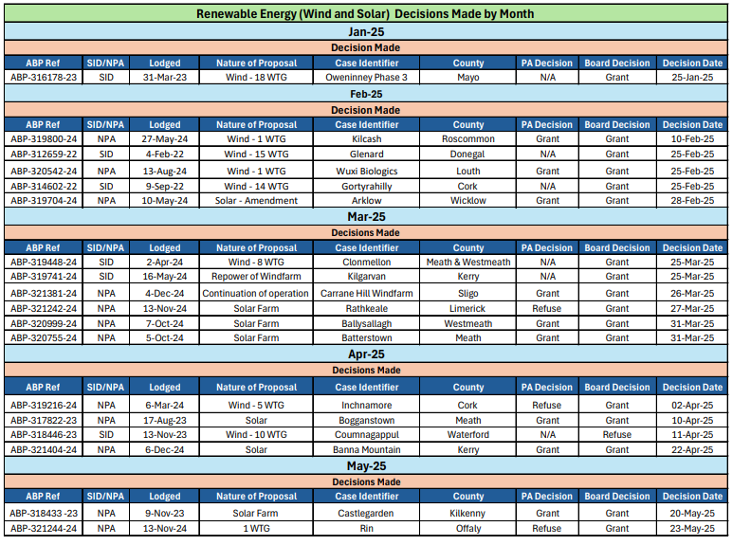
Renewables – 11 WF; 7 Solar

Slide 27
Older Cases – Actively Managing Pre-2024 Remaining Transport/ 7th Schedule/ LA Cases
Year | Total Cases
Pre and 2021 | 2
2022 | 1
2023 | 5

Slide 28
7th Schedule, Electricity, Local Authority and Road & Rail Cases 2025
Decision ‘types’ made 2025 include:
18 no. Local Authority decisions by the Board
4 no. Road cases (inc. 2 Bus Connects)
16 no. 7th Schedule (5 amendments; windfarms, Aughinish, Waste facilities)
Live Pre-apps consultations include:
27 no. Windfarms
25 no. Electricity cases
11 no. Power Generating/ Waste/hospital
1 no. Gas pipeline case

Slide 29
Transport Applications - Status
All 12 Dublin Bus Connects plus accompanying 12 CPOs decided by the Commission (last decision 12th May 25)
One Galway Bus Connects plus CPO decided, second due to be discharged by Inspector early Q4
Slane N2 bypass decision made
Outstanding decisions in large transport projects:
Airport (Noise) case decision due
Metro, LUAS Finglas, DART North decision due by end of Summer
Galway Road out for Public Consultation following receipt of updated documents

Slide 30
Case Targets for 2025 Cases and SOP compliance

Slide 31
Proposed Planning Casework Targets for Cases Lodged in 2025
Function | Output | Timeframe
Large Scale Residential Developments (LRD) | 95 - 100% disposed of within 16 weeks | Year end
Normal Planning Appeals | 70 - 80% of 2025 cases disposed of within SOP of 18 weeks | Year end
Vacant site levy appeals | 90 – 100% of cases disposed of within SOP | Year end
Derelict Site Appeals | 90-100% of cases disposed of within SOP | Year End
RZLT Appeals | 90 – 100% of cases disposed of within SOP | Year End
Electricity Cases | 70 – 80% of 2025 cases disposed of within the 2024 P&D Act timeline provisions (48 weeks) | Year end
Section 37(B) Private Applications | 75 – 85% of 2025 cases disposed of within the 2024 P&D Act timeline provisions (48 weeks) | Year end
Local Authority Projects (LAP) | 70 – 80% of 2025 cases disposed of within the 2024 P&D Act timeline provisions (26 weeks) | Year end
Strategic Infrastucture Developments (SID applications) | 70 – 80% % of 2025 cases disposed off within the 2024 P&D Act timeline provisions (48 weeks) | Year end

Slide 32
Stakeholder Engagement

Slide 33
Communications
External – Stakeholder Engagement
Bi-Annual Planning Forum (OPR Rec) meeting with full EMT- January 2025 and October 2025.
April 2025
  Environmental Non-Government Agencies (E-NGOs) - 8th and State Bodies - 9th
May 2025
  Seafood ORE Working Group
July 2025
  Oireachtas Members - 2nd and Business & Industry Groups - 3rd
  Prescribed Bodies – 9th
Groups/applicants asked to identify upcoming projects for resource planning and to identify the interdependency of projects/cases for decision i.e. housing/water/electricity.
Post quarterly statistics on caseload, NPA cases and Direct Applications on website.
Monthly wind energy statistics on website.

Slide 34
Judicial Review

Slide 35
Overview
Continued increase in judicial review of planning and environmental decisions.
Main driver is the unique costs protection regime in planning and environmental litigation.
Process and legal costs reforms set out in the Planning and Development Act, 2024.
Greater expedition introduced by the Planning and Environment Court, now underpinned by Order 103, Rules of the Superior Courts.

Slide 36
Judicial Review 2025
88 judicial reviews lodged with the High Court so far in 2025.
Papers in 73 served so far on the Commission, which include 282 domestic grounds of challenge, 74 EU law grounds and 20 validity grounds.
Judicial review by development type:
Commercial | 23 | Telecommunication mast | 7
Housing | 14 | RZLT / VSL | 5
Infrastructure | 11 | Renewable | 4
Single house / householder | 7 | Quarry | 2 (73)

Slide 37
Judicial Review 2024
147 applications for judicial review lodged with the High Court in 2024 and 143 served on the Commission so far.
The 143 were challenges to 139 Board decisions (a decision may be challenged by more than one judicial review) and consisting of 780 core grounds, made up of 591 domestic law grounds, 148 EU law grounds and 41 validity grounds.
Commercial | 35 | Infrastructure | 19
Housing 2 – 99 | 21 | Renewable | 17
Housing LRD | 7 | Telecoms mast | 15
Housing SHD | 4 | RZLT | 10
Single house / householder | 11 | Derelict site | 4 (143)

Slide 38
Judicial Review & Infrastructure
30 infrastructure judicial reviews initiated in 2024 and so far in 2025 and related to the following types of infrastructure development.
Progress of litigation as of 27 June 2025:
Bus Connects | 16 | Electricity | 2
Railway & port | 5 | Water | 2
Local authority | 4 | Education | 1
Not assigned hearing date | 21 | Decided & ongoing appeal | 2
Assigned hearing date | 0 | Decided | 1
Heard and awaiting judgment | 2 | Withdrawn by applicant for judicial review | 4

Slide 39
Historic Overview of Judicial Review
The following two slides provide a historic overview of the increase in judicial review, updated to the 26 June 2025.
The first slide puts judicial review against An Coimisiún Pleanála into perspective, compared to general non-asylum judicial review.
The second slide charts the increase in judicial review against An Coimisiún Pleanála against legislative changes and case law, most notably the Heather Hill judgment of the Supreme Court.

Slide 40
Statistical Overview – Historical (1)

Slide 41
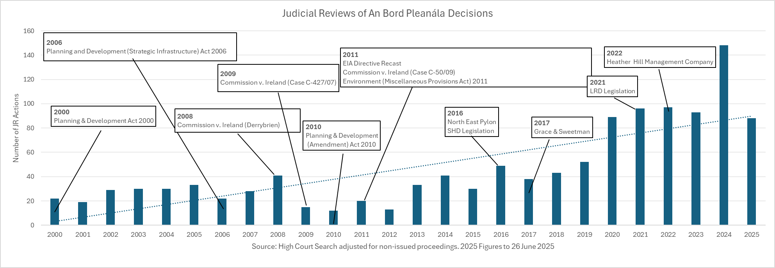
Statistical Overview – Historical (2)

Slide 42
Approach of An Coimisiún in Judicial Review
ACP is the legitimus contradictor so defends judicial reviews of its decisions.
It assesses the strength of the grounds pleaded in the Statement of Grounds.
It contests leave or standing where appropriate to do so.
It seeks the expedition of cases, subject to the current capacity of the Courts.
It has changed remittal procedures so that remittals occur faster and files do not go back to the end of the queue.

Slide 43
Part 9, Planning and Development Act 2024
Section 288 of the 2024 Act will be particularly important for linear infrastructure projects as it allows the amendment of a planning decision to correct an error and avoid the whole decision being quashed.
Part 9, Chapter 1 sets out changes in judicial review to streamline the process. Now mirrored by the Order 103, Rules of the Superior Courts regarding the management of the Planning & Environment Court.
Part 9, Chapter 2 sets out measures to address legal costs in environmental cases, including a scale of fees.

Slide 44
Resourcing Update

Slide 45
Overview of Resourcing 2022 – Mid 2025
FTE | Board | Senior Management | Inspectorate | Administration | Total
End 2022 | 5 | 18 | 66 (1) | 113 | 202
End 2023 | 15 | 22 | 86 (3) | 131 | 254
End 2024 | 17 | 27 | 100 (3) | 146 | 290
2022 v 2024 |  |  |  |  | +43%
End June 2025 | 15 | 27 | 101(6) | 156 | 299
Sanctioned FTE |  |  |  |  | 313
Period: Jan-July 2025 New Starters 24(3 due to start July) Leavers 15(2 due to leave July) Promotions 7

Slide 46
Recruitment Competitions
2022 – June 2025

Slide 47
New Starters 2022 – June 2025

Slide 48
Transformation & Digital Services

Slide 49
Transformation & Digital Services
Online services in collaboration with OGCIO
  Providing online capability for submission of normal planning appeals (NPA) and payments, leveraging the government’s ‘shared services’ IT platform. Expected go-live Q3 2025.
Digital Public Case Files for Direct Applications
  In Q3 all new Direct Applications (Strategic Infrastructure etc) case files will be published on our website. The public will no longer need to come to our office to view hard copy files.
Evaluation of AI & Automation capabilities
  Collaborating with Local Authorities and CeADAR, the government’s centre for AI, on developing a proof-of-concept AI capability. Continuing IT automation for process efficiencies.
  Collaboration on potential AI use to ensure risk management, data & security mitigations, and adherence to all guidelines for the Responsible Use of AI in the Public Service.

